Slide 1

Vel Tech Rangarajan Dr. Sagunthala R&D Institute of Science and Technology
School of Computing
Department of Computer Science and Engineering
10211CS224 / FULL STACK APPLICATION DEVELOPMENT (JAVA)
PROJECT REVIEW : MILESTONE PROJECT – 1
Date: 26-03-2026
Real-Time Event Synchronization Engine
SDG No 9 : Industry, Innovation and Infrastructure
Presented By:
P.Uday kumar – VTU26529 – 23UECS1179
Courses Handling Faculty :
Dr. HAFIZUR RAHMAN B.Tech.,M.Tech.,Ph.D.

Slide 2
INTRODUCTION
1
Many organizations still manage events manually using spreadsheets or paper records.
This often leads to scheduling conflicts, missed deadlines, and poor communication.
A centralized system is needed to track events efficiently in real time.
This project improves coordination and reduces human errors.
It is highly relevant for schools, colleges, companies, and event organizers.
Real-time updates help users monitor event status instantly.
The system allows users to add, view, and manage events easily.
EventSync provides a simple, secure, and user-friendly event management platform.
2
3
4
5
6
7
8
9

Slide 3
PROBLEM STATEMENT
1
2
Many institutions and organizations struggle with inefficient event coordination.
Event information is often scattered across emails, chats, and spreadsheets.
Lack of real-time updates causes confusion among participants and organizers.
Manual tracking increases errors in scheduling and time management.
There is limited transparency in monitoring event status and progress.
Communication delays can affect attendance and overall event success.
Existing systems are either too complex or not fully automated.
Hence, there is a need for a centralized, reliable, and real-time event management solution.
3
4
5
6
7
8
9

Slide 4
OBJECTIVE(S)
1
2
3
To design and develop a real-time web-based event management system.
To implement automated event scheduling and status tracking features.
To improve coordination and reduce manual errors through centralized data management.
To evaluate the system’s performance in terms of accuracy, usability, and response time.
4
5
6
7
8
9

Slide 5
PROPOSED SYSTEM
1
2
The proposed system is a Web-Based Event Scheduling Application built using PHP and MySQL.
It allows users to securely register and log in to manage event records.
All event information is stored in a centralized database system.
Users can add, edit, view, and remove events easily.
The system provides a simple and interactive dashboard for management.
It reduces manual paperwork and time consumption.
The application ensures accurate and organized data handling.
Compared to traditional methods, it offers a more efficient and user-friendly solution.
3
4
5
6
7
8
9

Slide 6
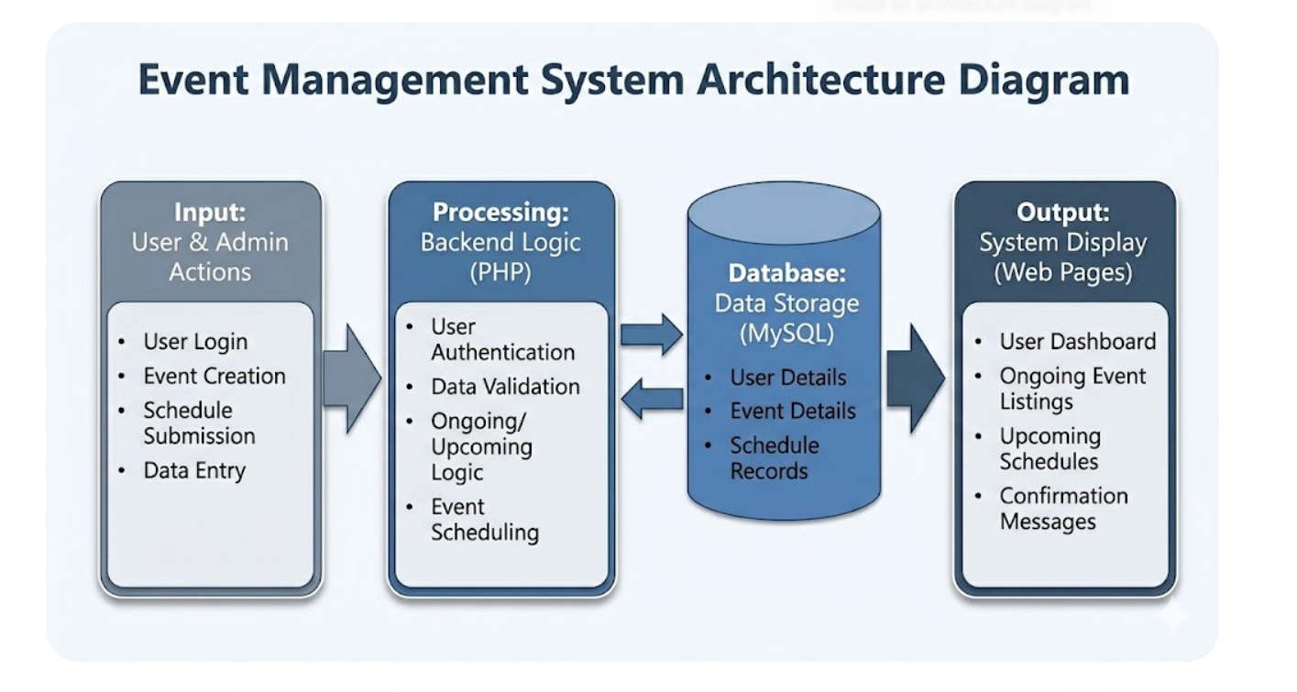
PROPOSED SYSTEM ARCHITECTURE
1
2
3
4
5
6
7
8
9

Slide 7
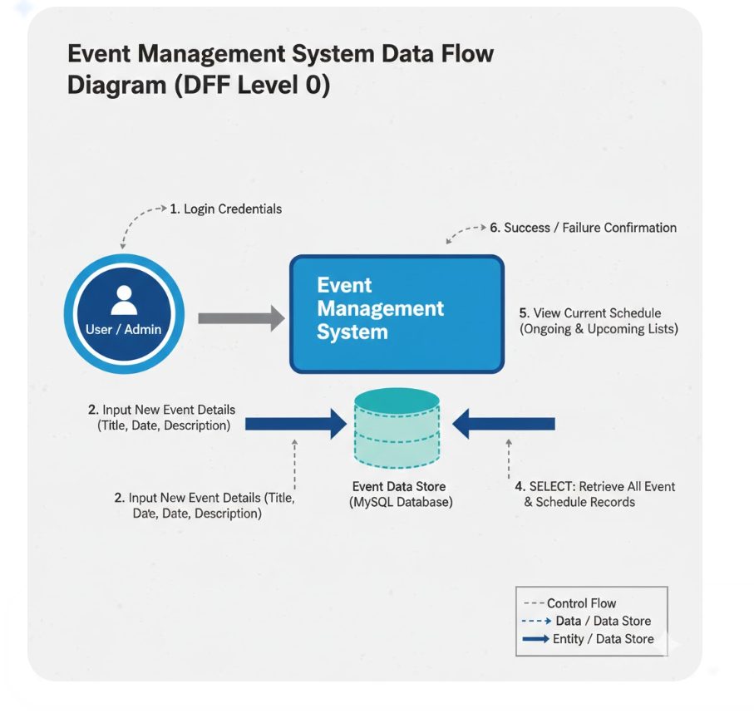
WORKFLOW
1
2
3
4
5
6
7
8
9

Slide 8
TECHNOLOGIES USED
Frontend:
HTML5
CSS3
JavaScript
Bootstrap
Backend:
PHP
Database:
MySQL
Tools:
VS Code
XAMPP
Hardware / Software Requirements:
Intel i3 or above
4GB RAM (Minimum)
Windows 10/11
Web Browser (Chrome/Edge)
XAMPP Server
1
2
3
4
5
6
7
8
9

Slide 9
MODULE DESCRIPTION
Module 1: Authentication & User Management
This module handles student and admin registration, login, and logout functionality.
It ensures secure authentication and maintains user sessions.
Module 2: Finance Management
This module manages student fee details and payment records.
It allows updating transaction status and tracking pending payments.
Module 3: Database Management
This module connects the application to the MySQL database.
It performs data insertion, retrieval, updating, and deletion operations.
Module 4: Dashboard & Reporting
This module displays financial summaries and payment history.
It generates structured reports for better monitoring.
1
2
3
4
5
6
7
8
9

Slide 10
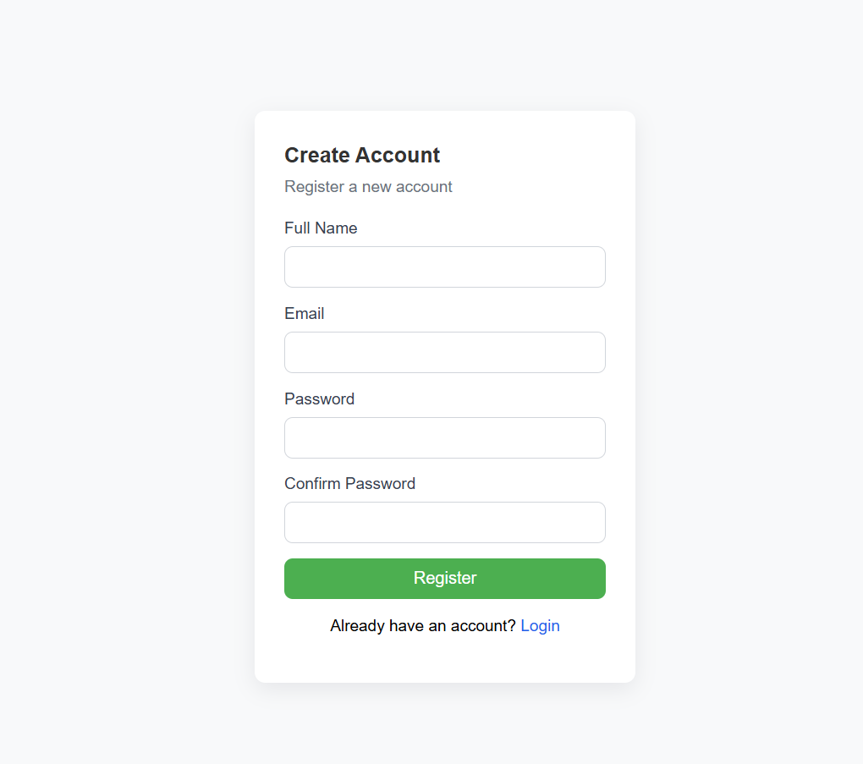
IMPLEMENTATION SCREENSHOTS
1
Allows new users to create an account by entering required details such as name, email, and password with proper validation.
The entered information is securely stored in the database, enabling users to log in and access the system features.
2
3
4
5
6
7
8
9

Slide 11
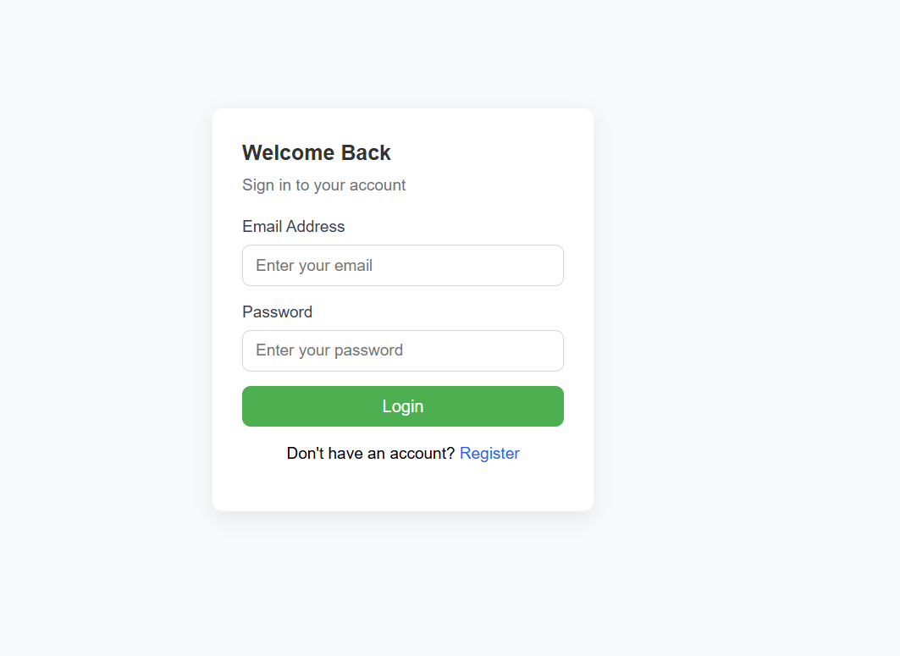
IMPLEMENTATION SCREENSHOTS
Allows registered users to enter their email and password to securely access their account within the system.
The system verifies the credentials with the database and grants access to the dashboard upon successful authentication.
1
2
3
4
5
6
7
8(A)
9

Slide 12
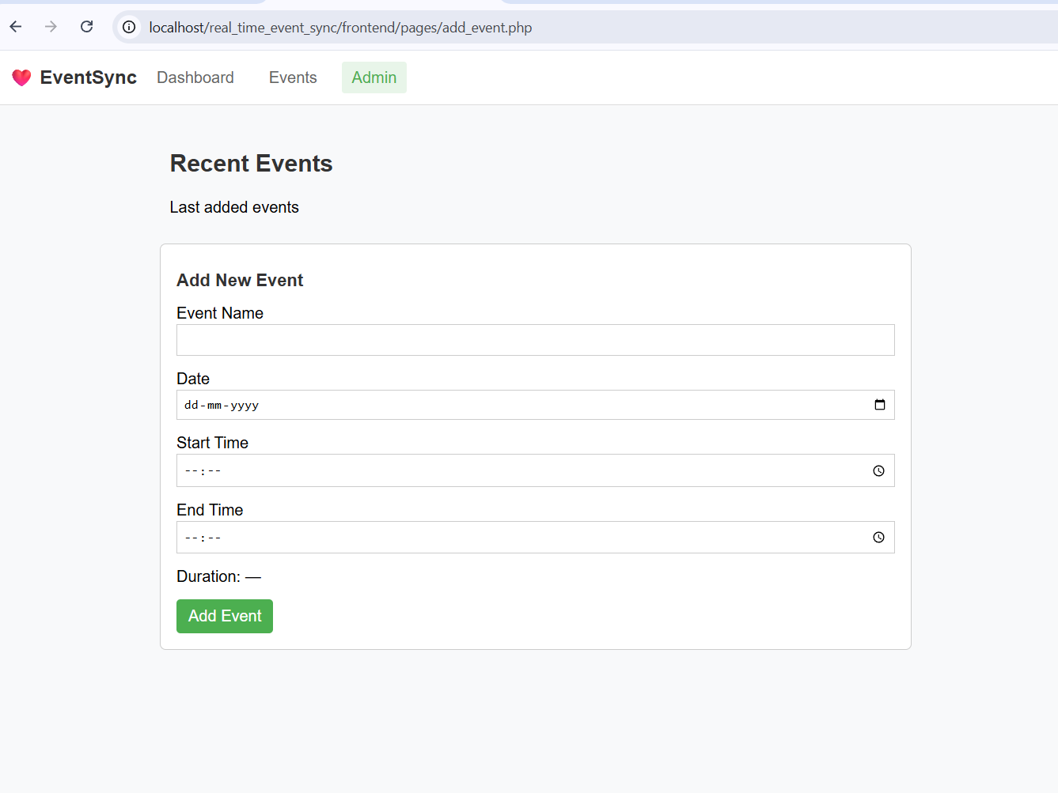
IMPLEMENTATION SCREENSHOTS
Allows the admin to create and add new event details such as event name, date, description, and other required information into the system.
The entered event data is validated and stored in the database, making it available for users to view and manage.
1
2
3
4
5
6
7
8(B)
9

Slide 13
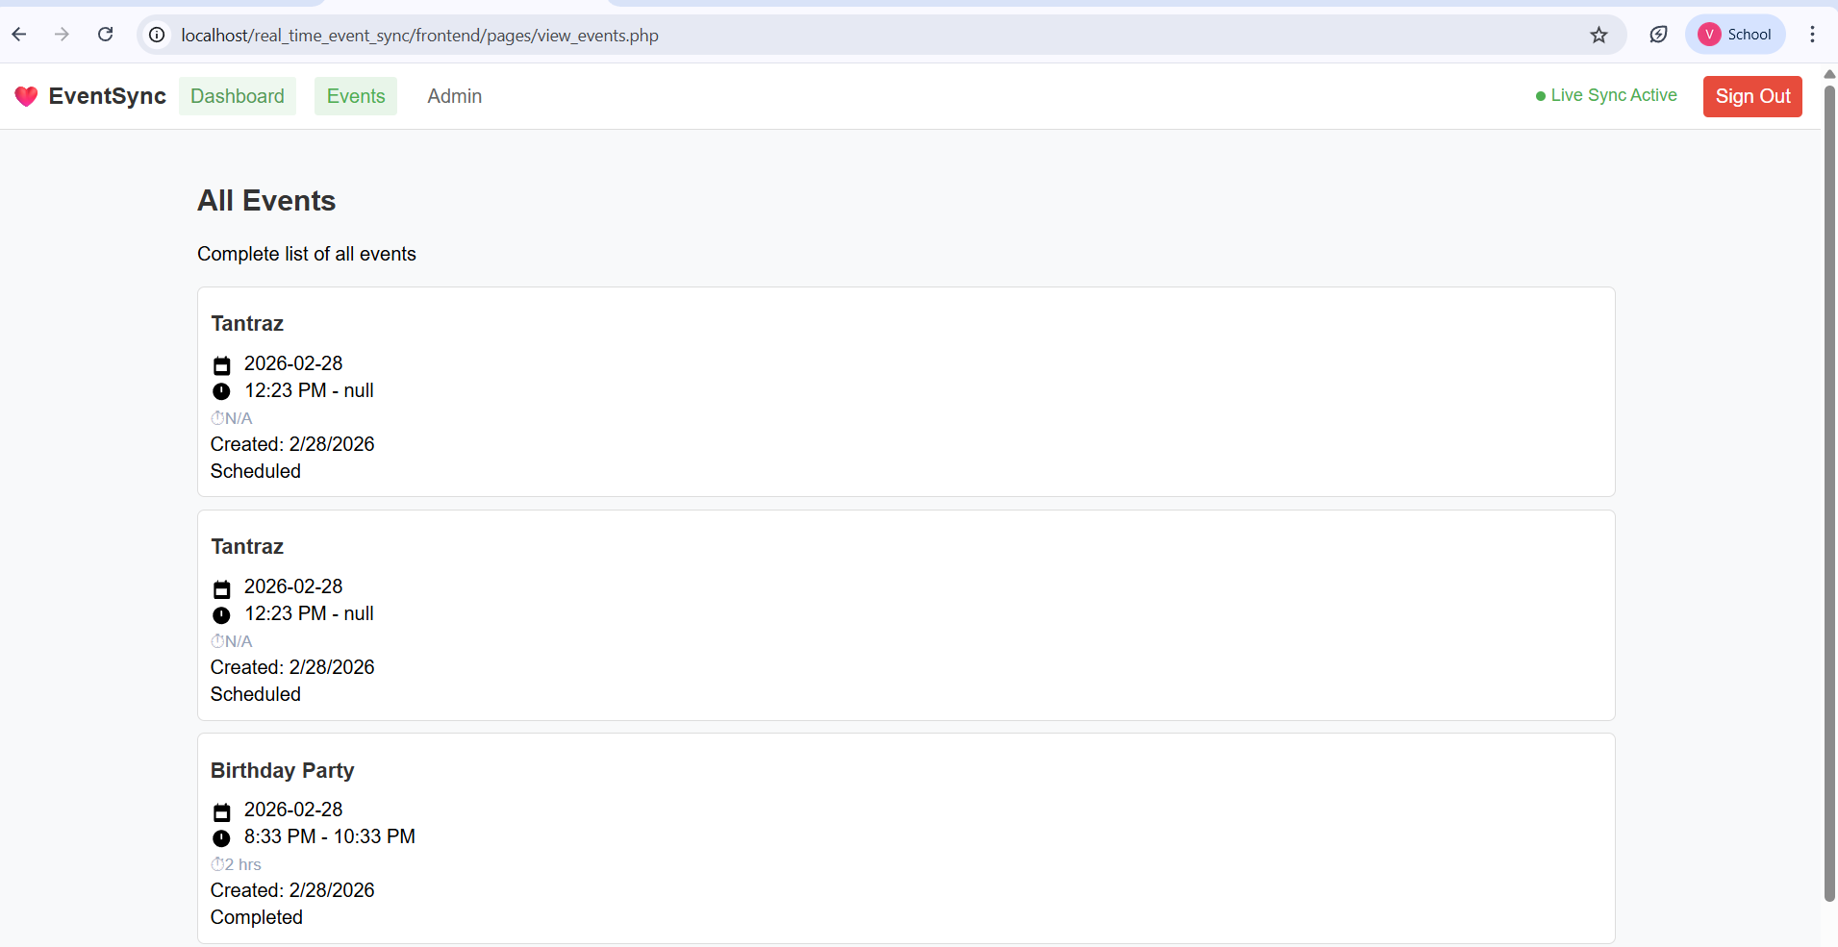
IMPLEMENTATION SCREENSHOTS
Displays a complete list of all created events with details such as event name, date, and description in an organized format.
Allows users or admin to view, update, or manage existing events efficiently from a single dashboard page.
1
2
3
4
5
6
7
8(C)
9

Slide 14
ADVANTAGES & LIMITATIONS
1
Advantages:
Provides a centralized platform to manage events efficiently in one place.
Reduces manual work by automating event creation, storage, and retrieval.
Ensures secure access through authentication and role-based control.
Easy to use interface improves user experience and system accessibility.
Limitations:
Requires internet connection and server availability to function properly.
Limited scalability if hosted on a local server environment like XAMPP.
Security risks may occur if proper encryption and validation are not implemented.
Performance may reduce with large data if optimization is not done.
2
3
4
5
6
7
8
9

Slide 15
Thank you

